Slide 1
Operating-System Structures
Xin Liu
xl24j@fsu.edu
COP 4610 Operating Systems

Slide 2
Outline
Operating System Services
Identify services provided by an operating system
Operating System Structure
Compare and contrast monolithic, layered, microkernel, modular, and hybrid strategies for designing operating systems
User and Operating System-Interface (Shell)
Design and implement kernel modules for interacting with a Linux kernel (Prepare for Project 1: Shell Programming)
System Calls
Illustrate how system calls are used to provide operating system services

Slide 3
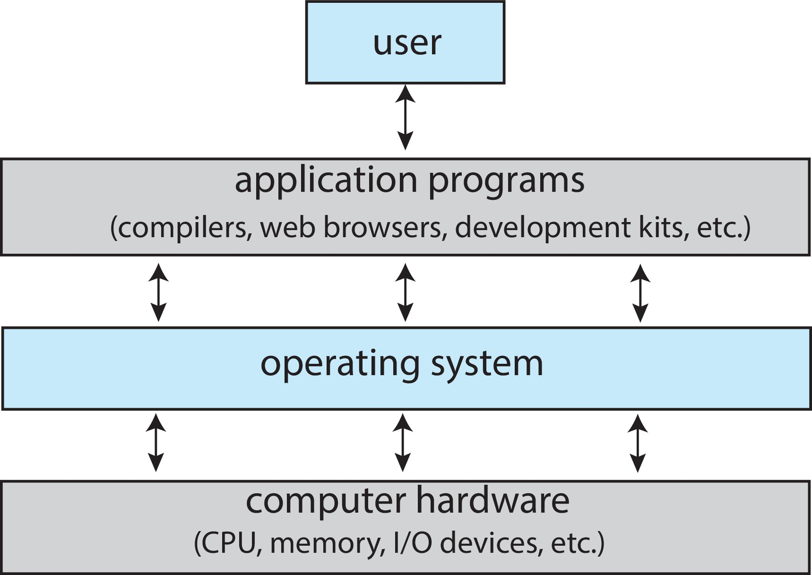
Abstract View of Components of Computer
OS is a program that acts as an intermediary between a user of a computer and the computer hardware.
OS hides the complexity and limitations of hardware from application programmers.

Slide 4
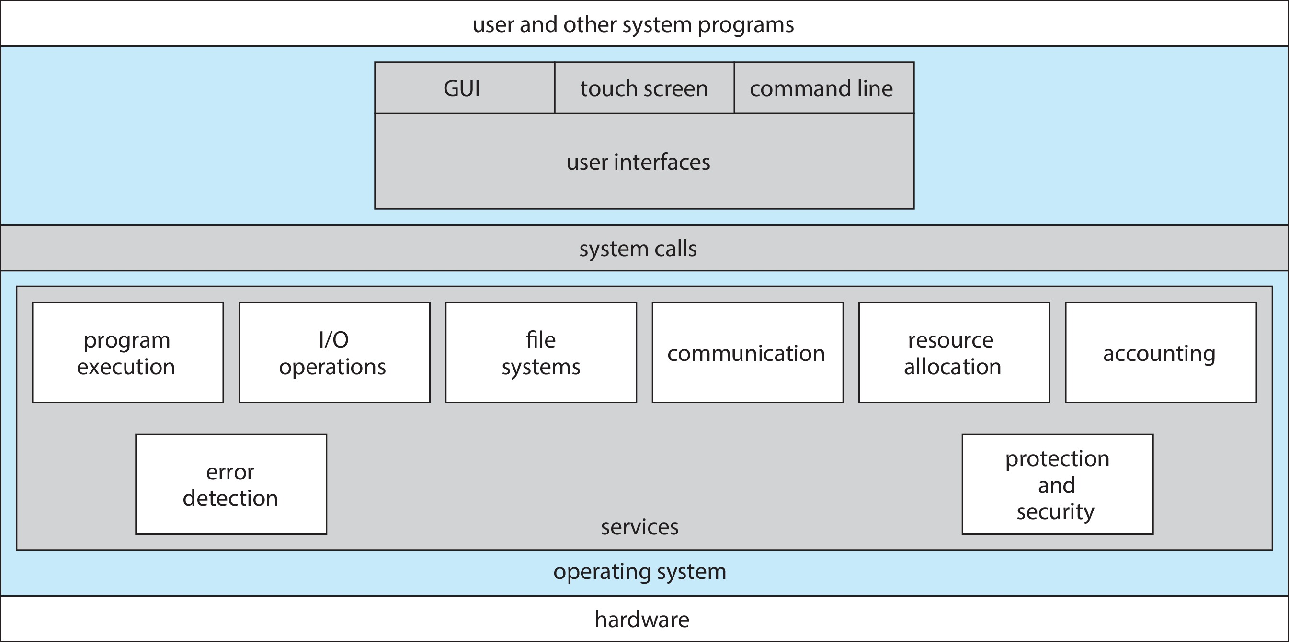
A View of Operating System Services

Slide 5
Operating System Services
User interface - Almost all operating systems have a user interface (UI).
Varies between Command-Line (CLI), Graphics User Interface (GUI), touch-screen, Batch
Program execution - The system must be able to load a program into memory and to run that program, end execution, either normally or abnormally (indicating error)
I/O operations - A running program may require I/O, which may involve a file or an I/O device
File-system manipulation - The file system is of particular interest. Programs need to read and write files and directories, create and delete them, search them, list file Information, permission management.

Slide 6
Operating System Services (Cont.)
Communications – Processes may exchange information, on the same computer or between computers over a network
Communications may be via shared memory or through message passing (packets moved by the OS)
Error detection – OS needs to be constantly aware of possible errors
May occur in the CPU and memory hardware, in I/O devices, in user program
For each type of error, OS should take the appropriate action to ensure correct and consistent computing
Debugging facilities can greatly enhance the user’s and programmer’s abilities to efficiently use the system

Slide 7
Operating System Services (Cont.)
Resource allocation - When multiple users or multiple jobs running concurrently, resources must be allocated to each of them
Many types of resources - CPU cycles, main memory, file storage, I/O devices.
Logging - To keep track of which users use how much and what kinds of computer resources
Protection and security - The owners of information stored in a multiuser or networked computer system may want to control use of that information, concurrent processes should not interfere with each other
Protection involves ensuring that all access to system resources is controlled
Security of the system from outsiders requires user authentication, extends to defending external I/O devices from invalid access attempts

Slide 8
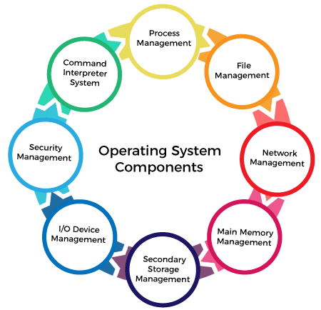

Slide 9
Operating System Component
Process Management: Supports program execution, resource allocation, and scheduling of processes. It ensures that multiple processes can run simultaneously without conflict.
File Management: Handles file-system manipulation, including reading, writing, creating, deleting files, and managing directories. It also supports I/O operations related to file access.
Network Management: Facilitates communications between processes, either on the same machine or over a network, ensuring data exchange via shared memory or message passing.

Slide 10
Operating System Component (Cont.)
Main Memory Management: Supports the loading of programs into memory, managing the allocation of memory, and ensuring that the memory is used efficiently.
Secondary Storage Management: Works alongside file management to handle the storage of data on disk drives, ensuring files and directories are properly stored and retrievable.
I/O Device Management: Manages the input and output devices, supporting I/O operations required by programs and ensuring proper device communication.

Slide 11
Operating System Services (Cont.)
Security Management: Supports protection and security services, ensuring that access to system resources is controlled and that the system is secure from unauthorized access.
Command Interpreter System: Supports the user interface (UI) by providing a way for users to interact with the operating system, whether through a Command-Line Interface (CLI) or a Graphical User Interface (GUI).

Slide 12
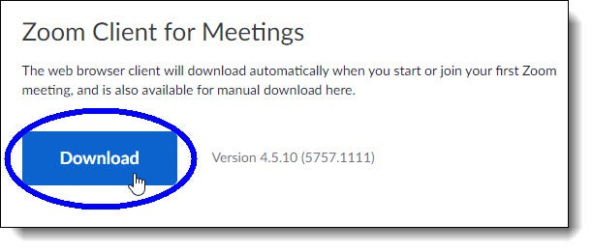
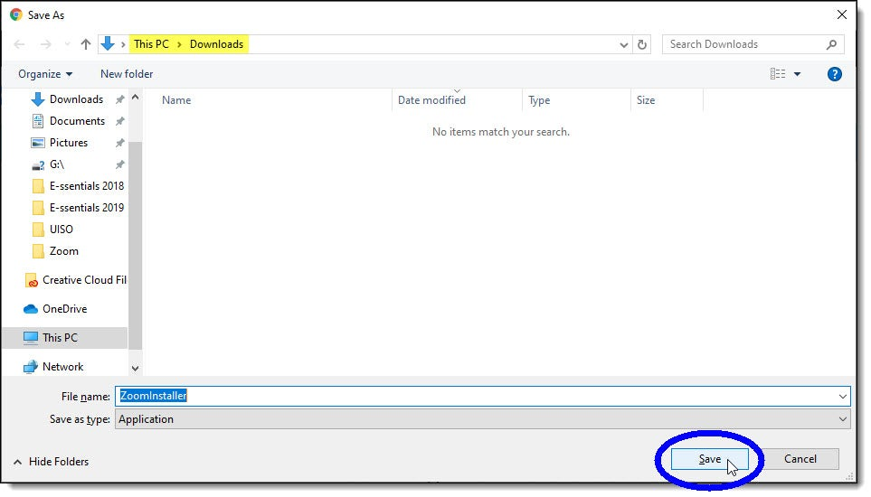
Example: How OS Components Manage Tasks with
Zoom (Windows)
Download Zoom
Go to the Zoom software download page.
Click Download and save the file to your local storage.
Primary Responsibility

Slide 13
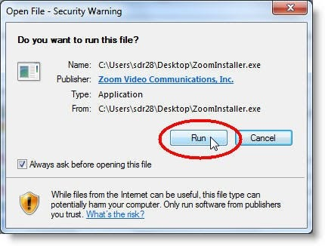
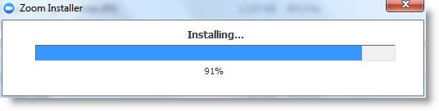
Example: How OS Components Manage Tasks with
Zoom (Cont.)
Start Installation
OS needs to start a new process to install the file.
Primary Responsibility

Slide 14
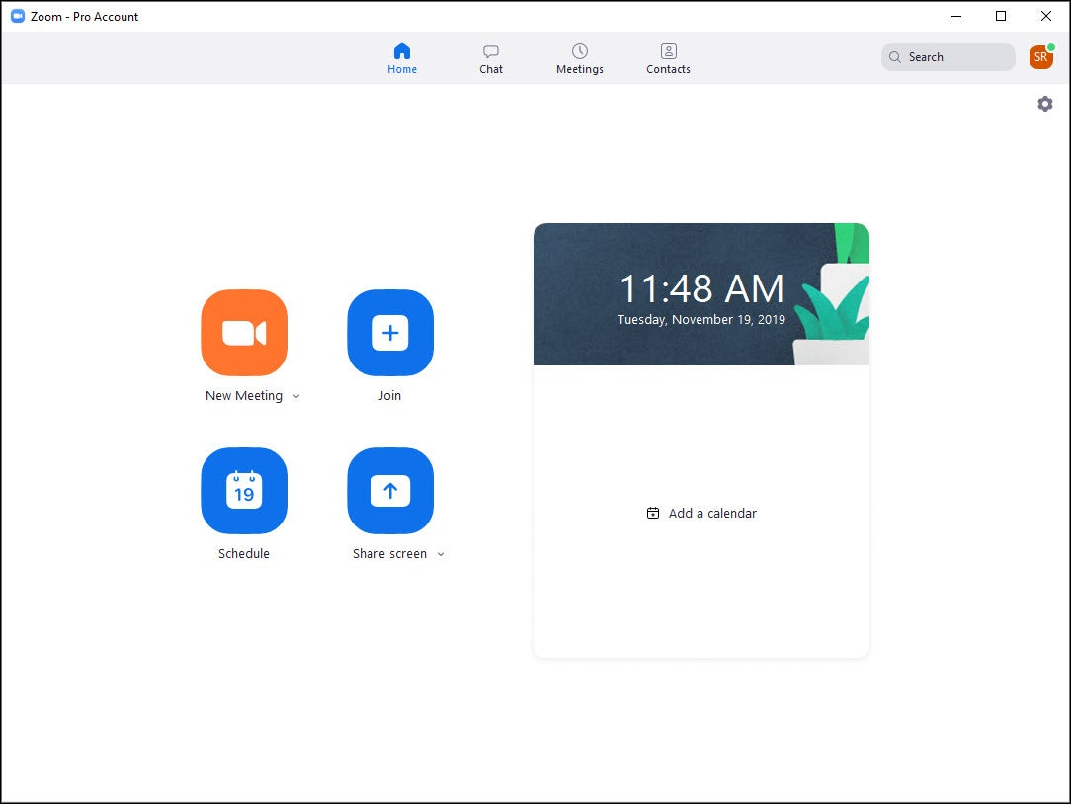
Example: How OS Components Manage Tasks with
Zoom (Cont.)
Run Zoom
The program needs to be loaded into memory to run.
Primary Responsibility

Slide 15
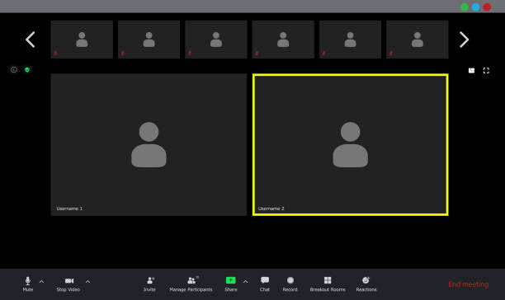
Example: How OS Components Manage Tasks with
Zoom (Cont.)
Use Zoom
Connect to the internet and use the camera, microphone, and speakers.
Primary Responsibility
Primary Responsibility

Slide 16
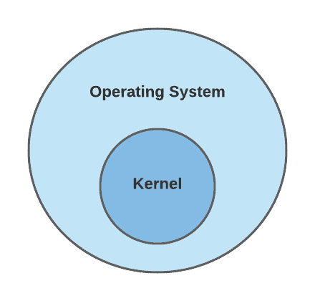
Kernel: The Core of the Operating System

Slide 17
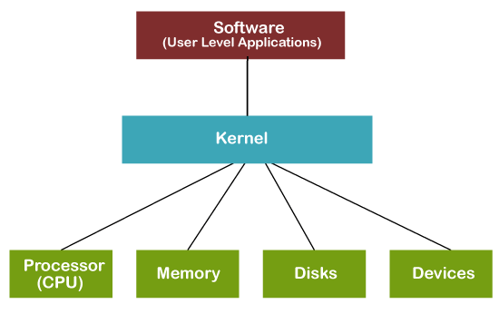
Kernel and Core Hardware Interaction
Processor (CPU): Manages process scheduling and execution.
Memory (RAM): Handles memory allocation and avoids conflicts.
Disk (Storage): Manages the file system, ensuring efficient and secure data storage.
Devices (I/O Devices): Controls communication between hardware and user-level applications.

Slide 18
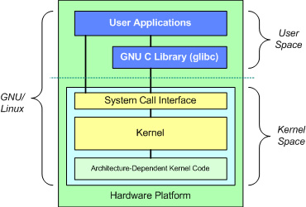
Kernel Space and User Space
Kernel space is the memory area where the operating system kernel runs, with the highest level of privileges.
Function: Manages system resources such as memory, CPU, and device drivers.
Security: Due to its high privileges, kernel space code must be very stable and secure; any errors can cause system crashes.
Access: Only code running in kernel mode can access kernel space; user mode code cannot directly access it.
User space is the memory area where regular applications run, with lower privileges.
Function: Runs user applications like browsers, text editors, etc.
Security: Errors in user space typically do not affect the overall system stability due to its lower privileges.
Access: Code running in user mode can only access user space and must use system calls to interact with the kernel.

Slide 19
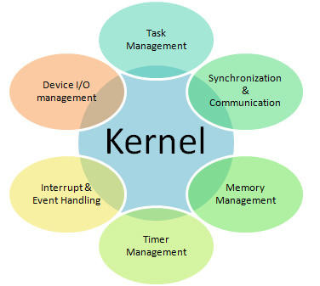
Understanding the Kernel
Task Management: Schedules and manages processes.
Memory Management: Allocates memory to processes.
Device I/O Management: Controls interactions with external devices.
Synchronization & Communication: Ensures smooth process interaction.
Interrupt & Event Handling: Responds to hardware events and interrupts.
Timer Management: Manages system time and timers.

Slide 20
Operating System Structure
General-purpose OS is very large program
Various ways to structure ones
Simple structure – MS-DOS
More complex – UNIX
Layered – an abstraction
Microkernel – Mach

Slide 21
Monolithic Structure: The Original UNIX Design
UNIX: Limited by hardware functionality
Simple Structure: The original UNIX OS had minimal structuring.
Two Parts:
System programs
The kernel
The Kernel:
Sits between system calls and physical hardware
Handles file system, CPU scheduling, memory management, and other OS functions—all within a single layer

Slide 22
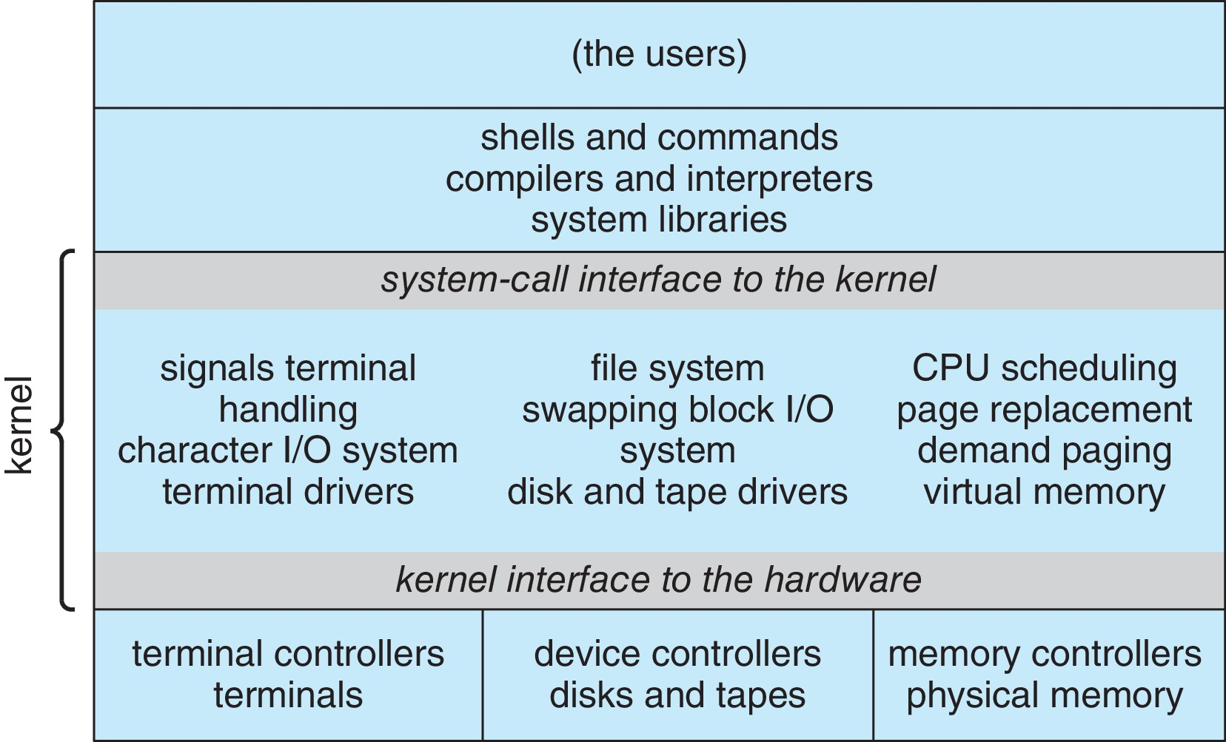
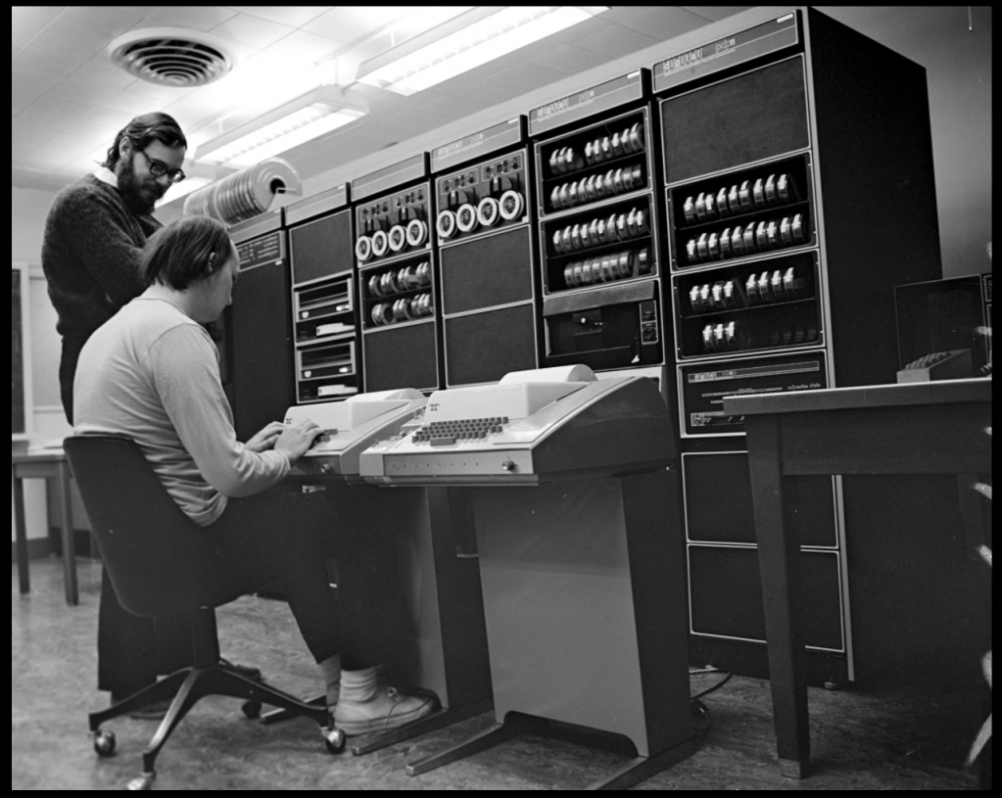
Traditional UNIX System Structure
Beyond simple but not fully layered
Kenneth Thompson
&
Dennis Ritchie

Slide 23
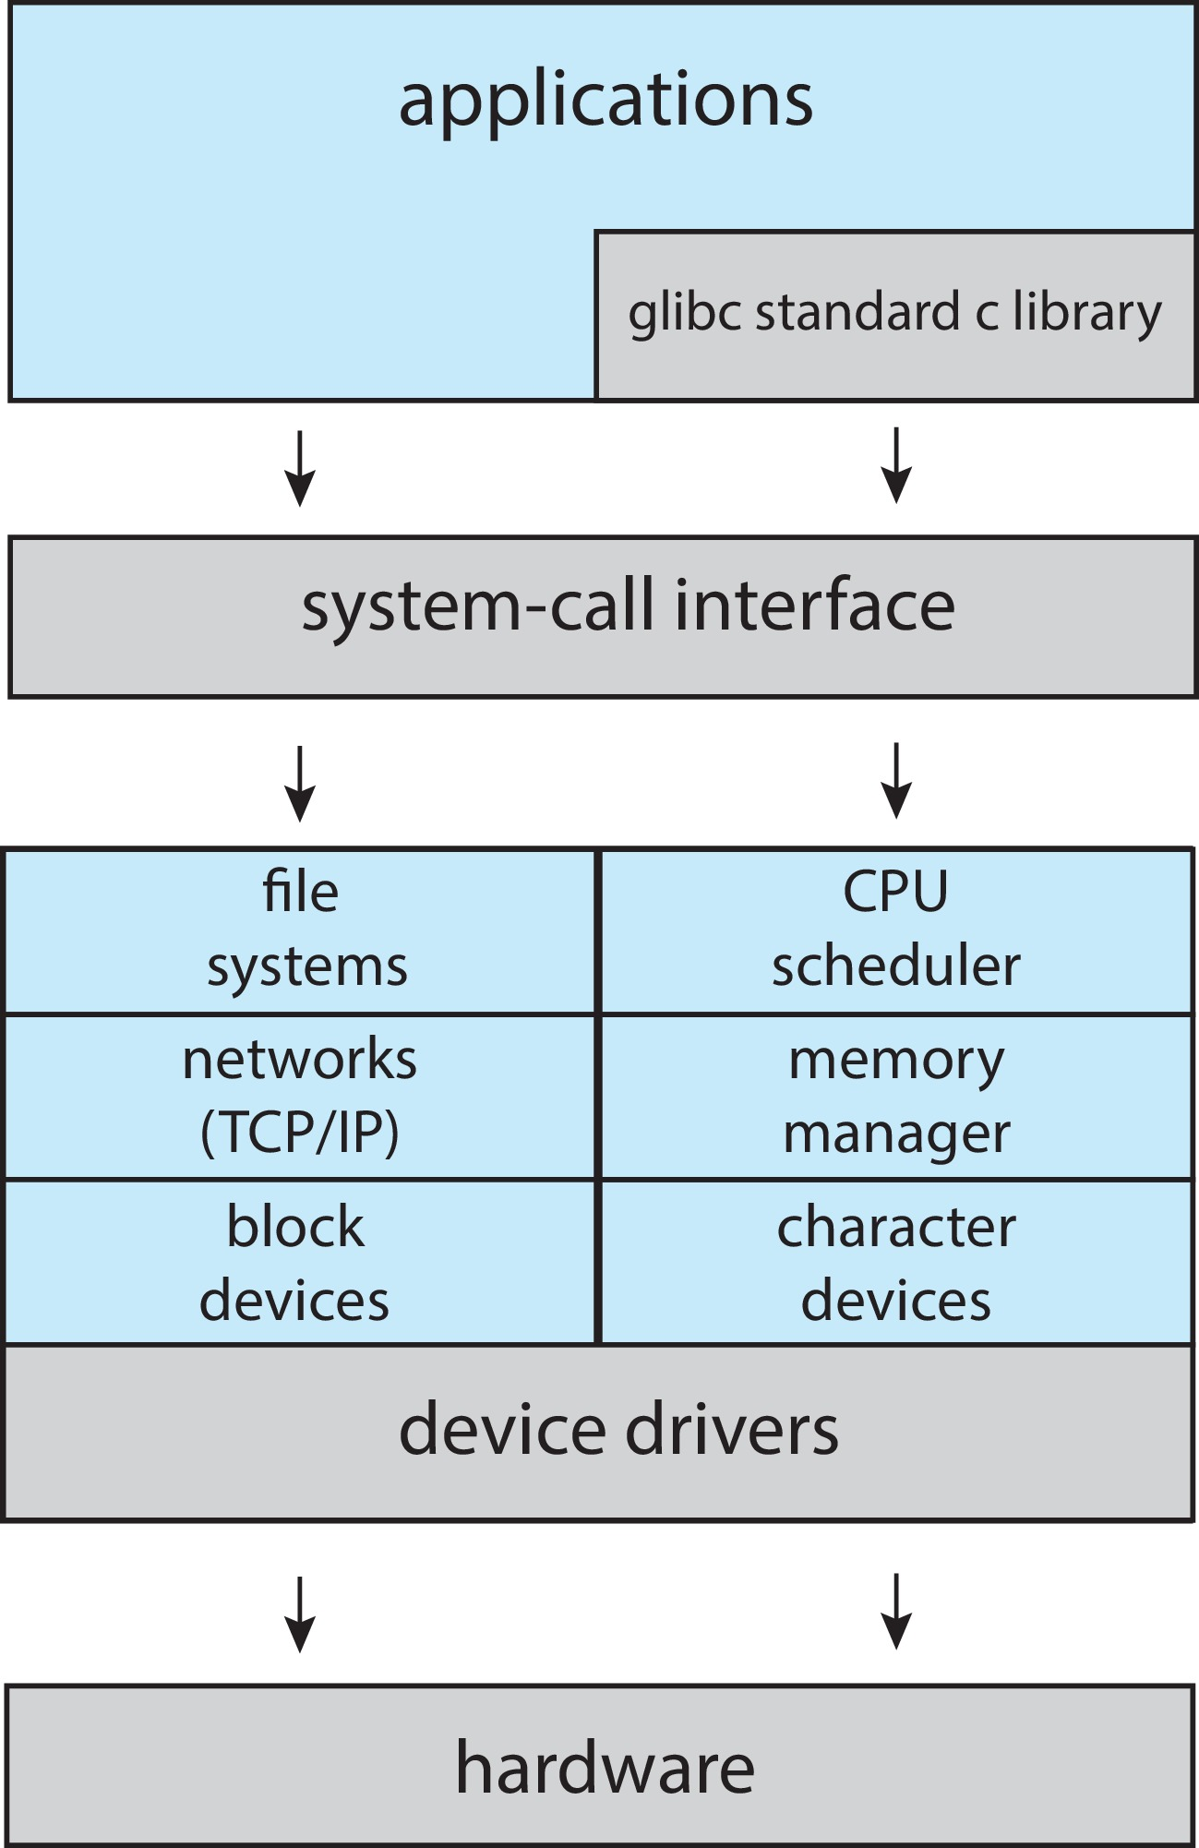

Linux System Structure
Monolithic plus modular design
Linus Torvalds

Slide 24
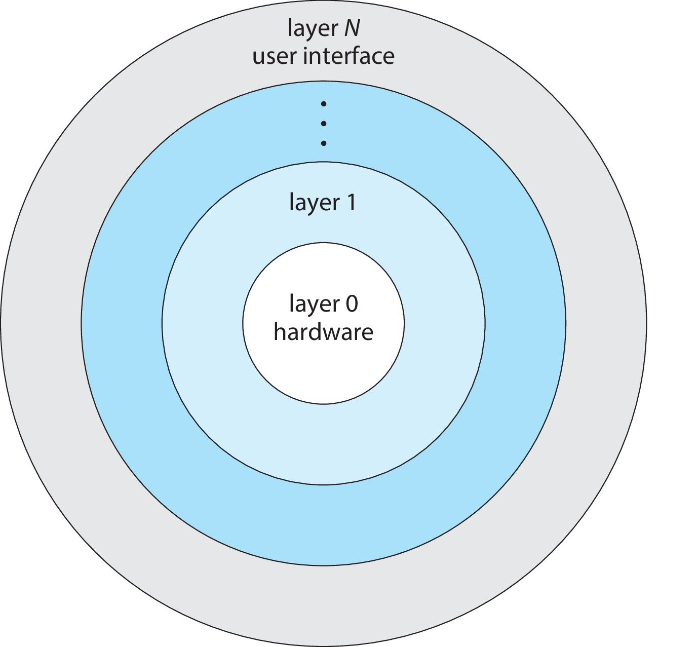
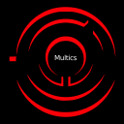
Layered Approach
The operating system is divided into a number of layers (levels), each built on top of lower layers. The bottom layer (layer 0), is the hardware; the highest (layer N) is the user interface.
With modularity, layers are selected such that each uses functions (operations) and services of only lower-level layers

Slide 25
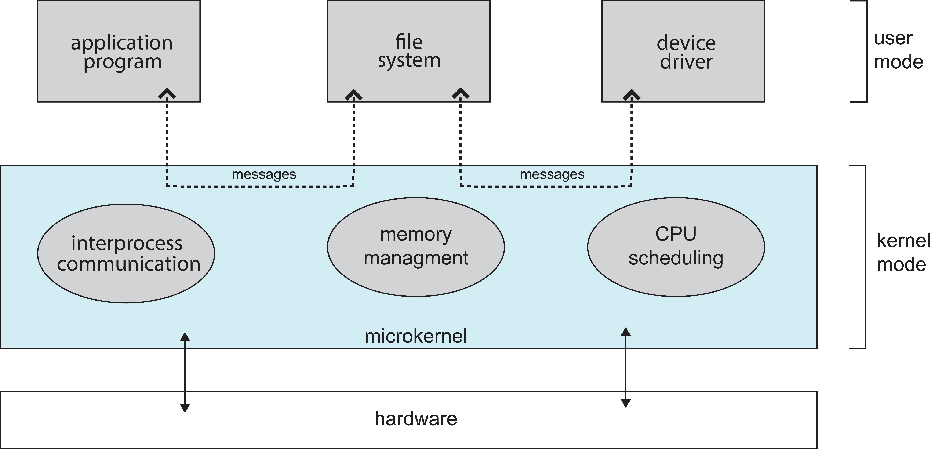
Microkernels
Moves as much from the kernel into user space
Communication takes place between user modules using message passing
Benefits:
Easier to extend a microkernel
Easier to port the operating system to new architectures
More reliable (less code is running in kernel mode)
More secure
Detriments:
Performance overhead of user space to kernel space communication

Slide 26
Modules
Many modern operating systems implement loadable kernel modules (LKMs)
Uses object-oriented approach
Each core component is separate
Each talks to the others over known interfaces
Each is loadable as needed within the kernel
Overall, similar to layers but with more flexible
Linux, Solaris, etc.

Slide 27
Hybrid Systems
Most modern operating systems are not one pure model
Hybrid combines multiple approaches to address performance, security, usability needs
Linux and Solaris kernels in kernel address space, so monolithic, plus modular for dynamic loading of functionality
Windows mostly monolithic, plus microkernel for different subsystem personalities
Apple Mac OS X hybrid, layered, Aqua UI plus Cocoa programming environment
Below is kernel consisting of Mach microkernel and BSD Unix parts, plus I/O kit and dynamically loadable modules (called kernel extensions)

Slide 28
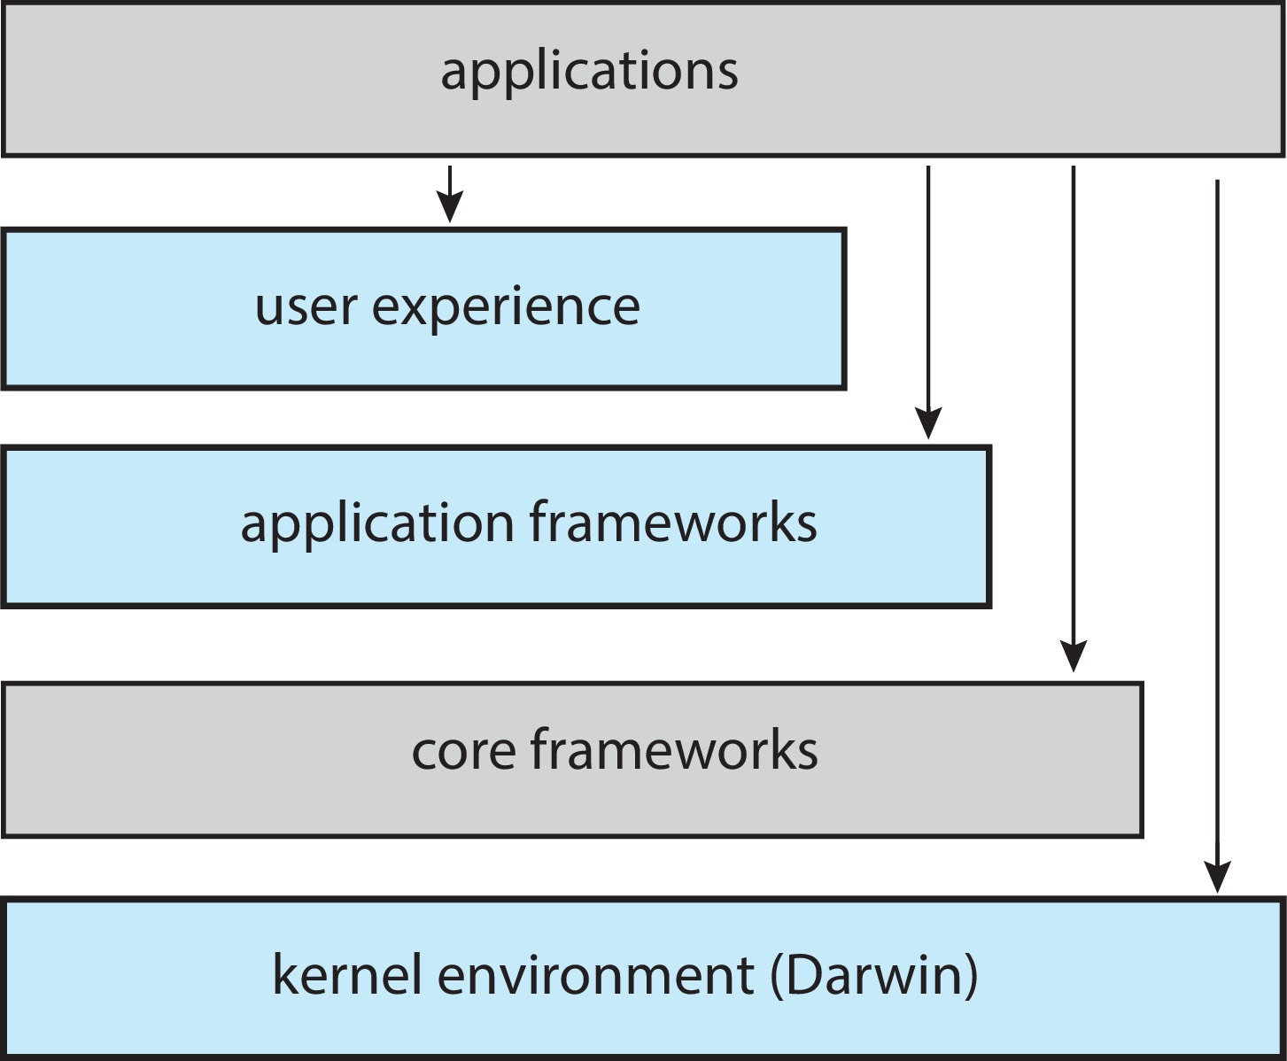
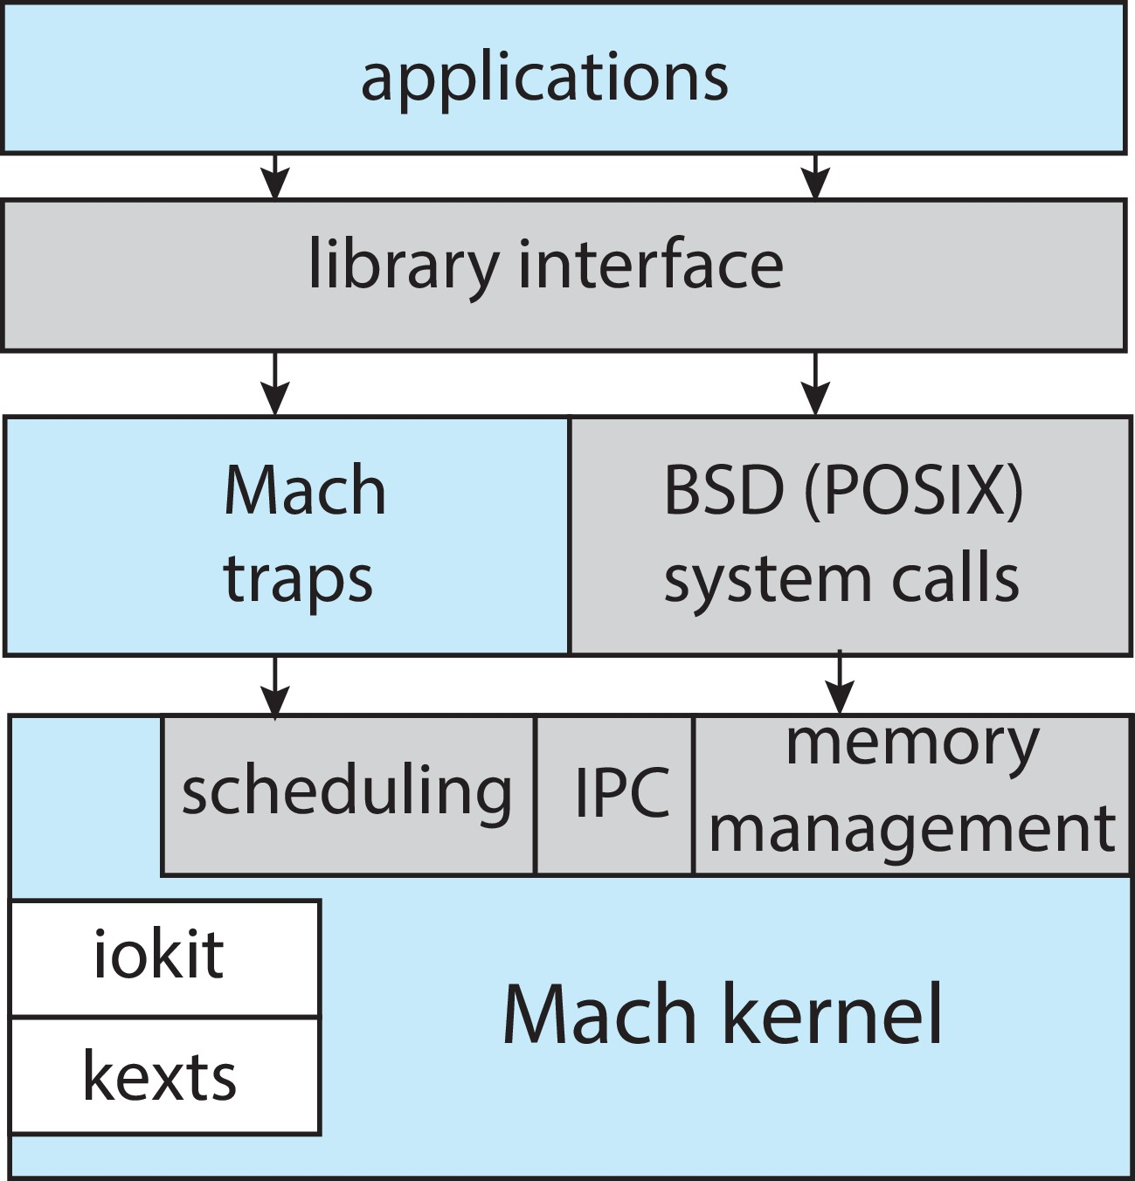
macOS and iOS Structure
Monolithic
Microkernel
Modules
Darwin

Slide 29
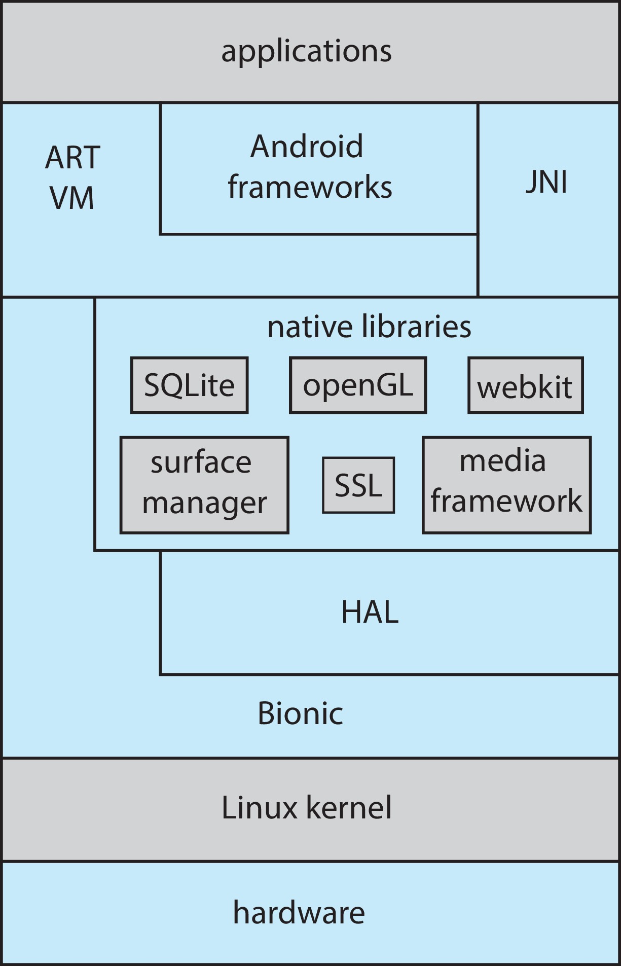
Android
Developed by Open Handset Alliance (mostly Google)
Open Source
Similar stack to iOS
Based on Linux kernel but modified
Provides process, memory, device-driver management
Adds power management
Runtime environment includes core set of libraries and Dalvik virtual machine
Apps developed in Java plus Android API
Java class files compiled to Java bytecode then translated to executable thnn runs in Dalvik VM
Libraries include frameworks for web browser (webkit), database (SQLite), multimedia, smaller libc

Slide 30
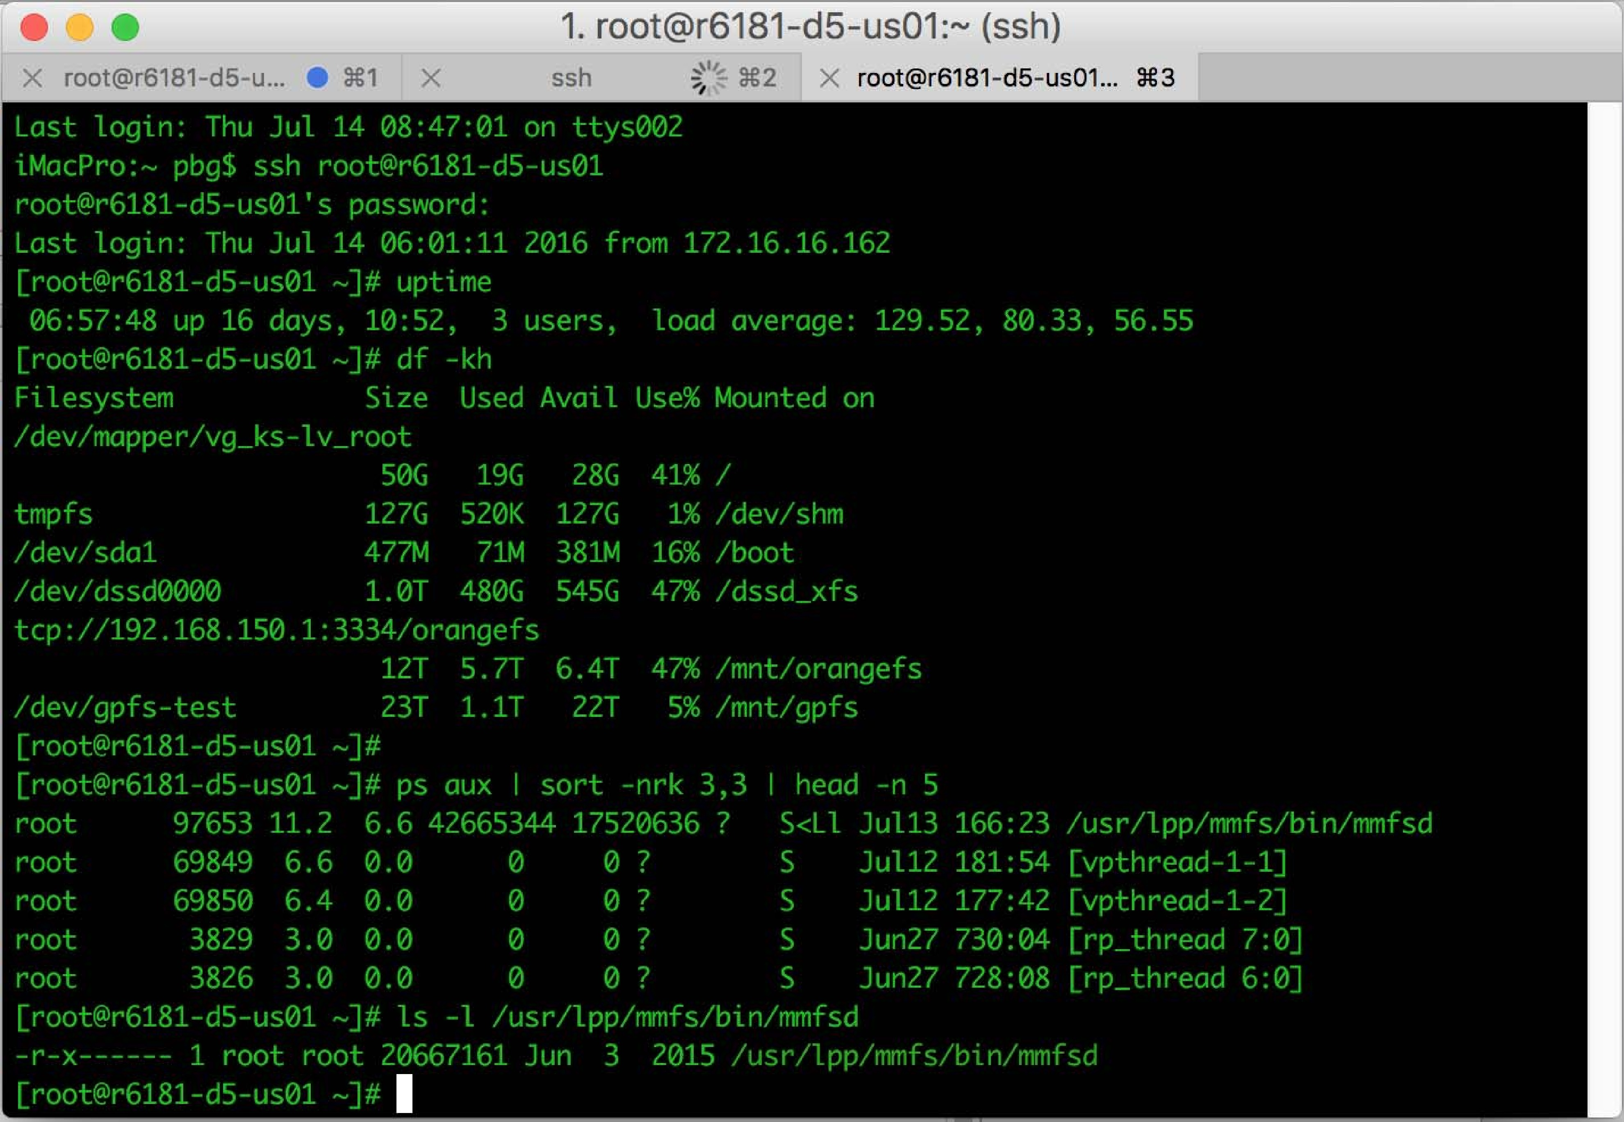
Command Line interpreter
Bourne Shell Command Interpreter
CLI allows direct command entry
Sometimes implemented in kernel, sometimes by systems program
Sometimes multiple flavors implemented – shells
Primarily fetches a command from user and executes it
Sometimes commands built-in, sometimes just names of programs
If the latter, adding new features doesn’t require shell modification

Slide 31
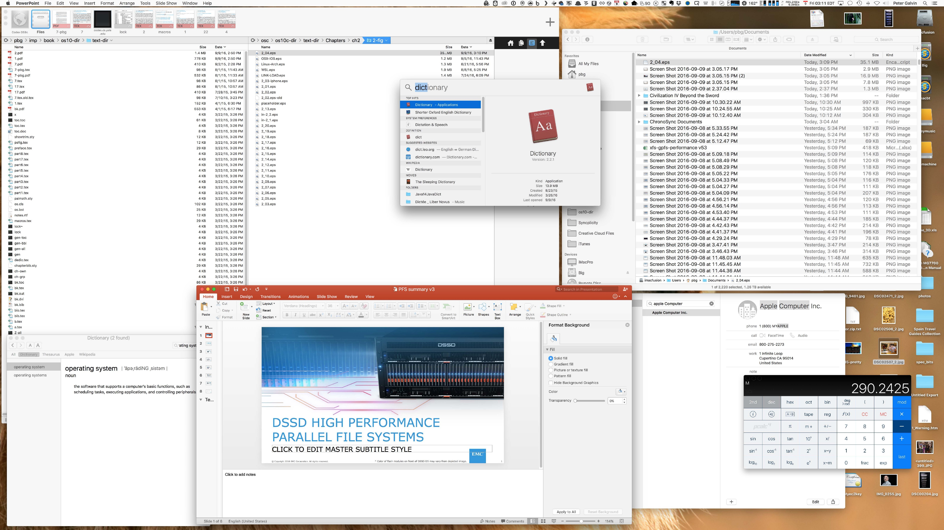

User Operating System Interface - GUI
User-friendly desktop metaphor interface
Usually mouse, keyboard, and monitor
Icons represent files, programs, actions, etc
Various mouse buttons over objects in the interface cause various actions (provide information, options, execute function, open directory (known as a folder)
Invented at Xerox PARC
Many systems now include both CLI and GUI interfaces
Microsoft Windows is GUI with CLI “command” shell
Apple Mac OS X is “Aqua” GUI interface with UNIX kernel underneath and shells available
Unix and Linux have CLI with optional GUI interfaces (CDE, KDE, GNOME)
MacOS GUI
Pirates of Silicon Valley

Slide 32
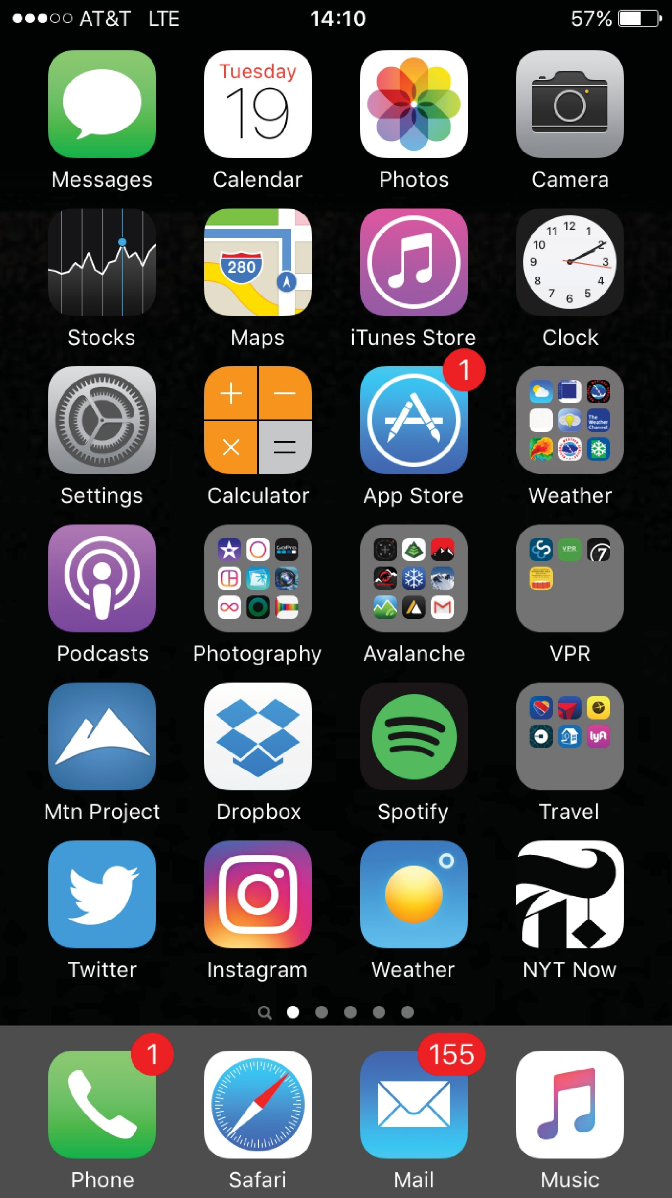
Touchscreen Interfaces
Touchscreen devices require new interfaces
Mouse not possible or not desired
Actions and selection based on gestures
Virtual keyboard for text entry
Voice commands

Slide 33
System Calls
Programming interface to the services provided by the OS
Typically written in a high-level language (C or C++)

Slide 34
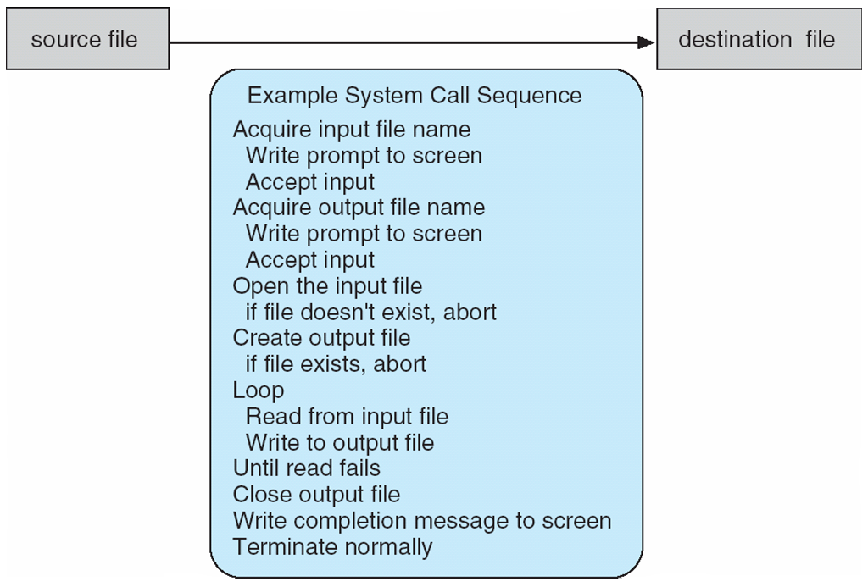
Example of System Calls
System call sequence to copy the contents of one file to another file

Slide 35
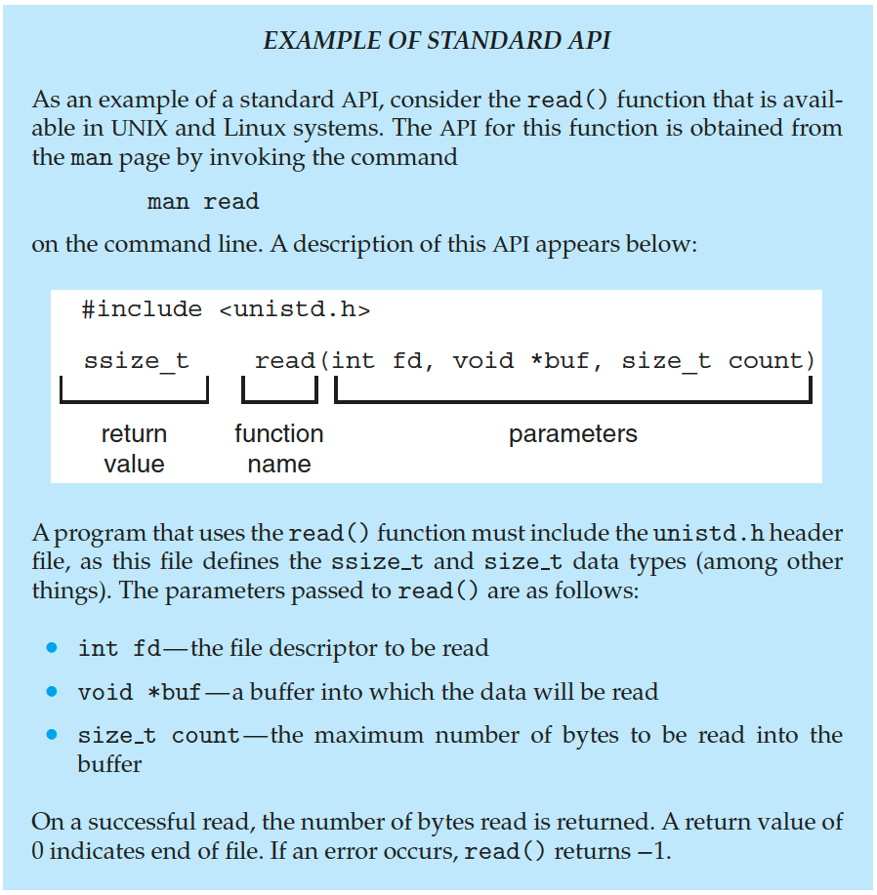
API
Mostly accessed by programs via a high-level Application Programming Interface (API) rather than direct system call use
Three most common APIs are Win32 API for Windows, POSIX API for POSIX-based systems (including virtually all versions of UNIX, Linux, and Mac OS X), and Java API for the Java virtual machine (JVM)

Slide 36
System Call Implementation
Typically, a number is associated with each system call
System-call interface maintains a table indexed according to these numbers
The system call interface invokes the intended system call in OS kernel and returns status of the system call and any return values
The caller need know nothing about how the system call is implemented
Just needs to obey API and understand what OS will do as a result call
Most details of OS interface hidden from programmer by API
Managed by run-time support library (set of functions built into libraries included with compiler)

Slide 37
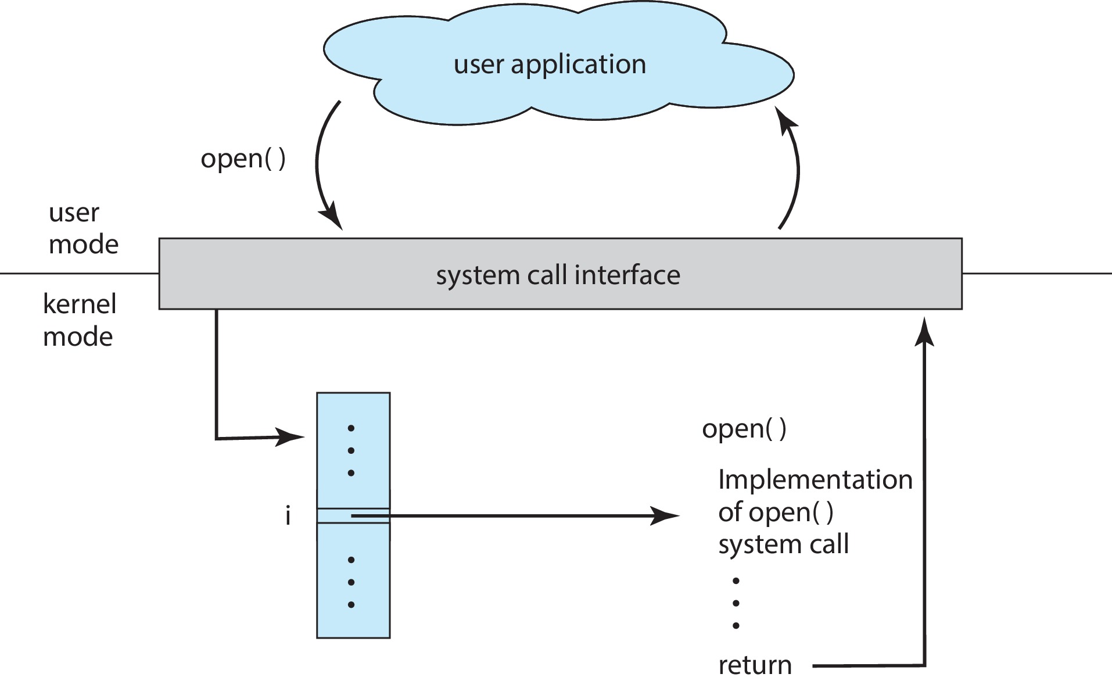
API – System Call – OS Relationship

Slide 38
System Call Parameter Passing
Often, more information is required than simply identity of desired system call
Exact type and amount of information vary according to OS and call
Three general methods used to pass parameters to the OS
Simplest: pass the parameters in registers
In some cases, may be more parameters than registers
Parameters stored in a block, or table, in memory, and address of block passed as a parameter in a register
This approach taken by Linux and Solaris
Parameters placed, or pushed, onto the stack by the program and popped off the stack by the operating system
Block and stack methods do not limit the number or length of parameters being passed

Slide 39
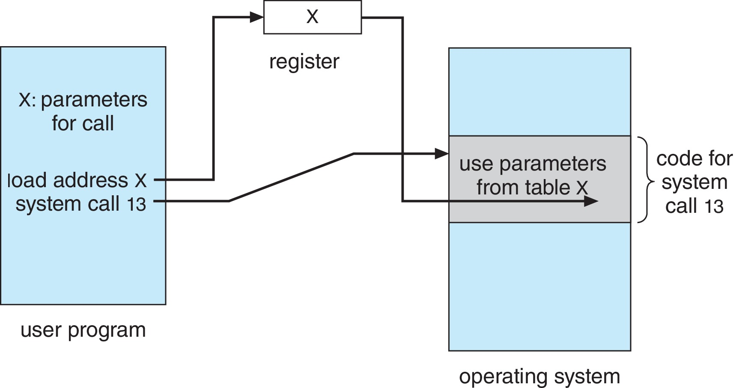
Parameter Passing via Table

Slide 40
Types of System Calls
Process control
create process, terminate process
end, abort
load, execute
get process attributes, set process attributes
wait for time
wait event, signal event
allocate and free memory
Dump memory if error
Debugger for determining bugs, single step execution
Locks for managing access to shared data between processes

Slide 41
Types of System Calls (Cont.)
File management
create file, delete file
open, close file
read, write, reposition
get and set file attributes
Device management
request device, release device
read, write, reposition
get device attributes, set device attributes
logically attach or detach devices

Slide 42
Types of System Calls (Cont.)
Information maintenance
get time or date, set time or date
get system data, set system data
get and set process, file, or device attributes
Communications
create, delete communication connection
send, receive messages if message passing model to host name or process name
From client to server
Shared-memory model create and gain access to memory regions
transfer status information
attach and detach remote devices

Slide 43
Types of System Calls (Cont.)
Protection
Control access to resources
Get and set permissions
Allow and deny user access

Slide 44
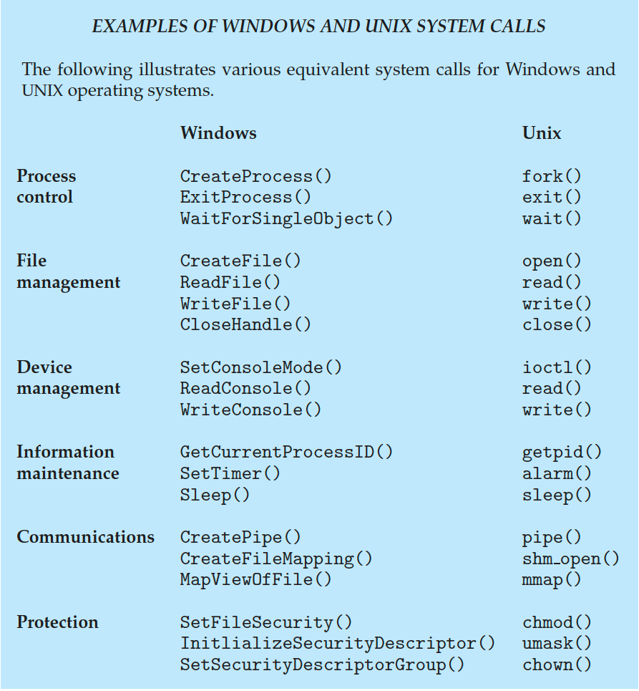
Examples of Windows and Unix System Calls

Slide 45
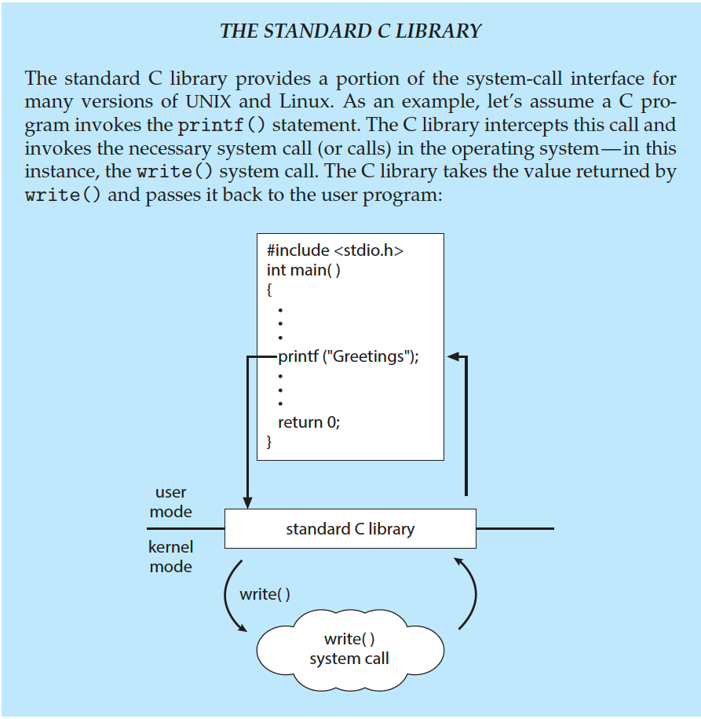
Standard C Library Example
C program invoking printf() library call, which calls write() system call

Slide 46
Takeaways
Kernel vs. User Space:
Kernel Space: Manages core system resources with high privilege.
User Space: Runs applications with limited privileges, accessing kernel via system calls.
Kernel Functions:
Manages processes, memory, devices, and system calls.
Design & Trends:
Monolithic, Layered, Microkernel, Modular
Trend: Hybrid (Based on the microkernel, driven by the rise of distributed networks, enabling platforms like watches, TVs, and laptops to run the same OS kernel while loading corresponding modules, including monolithic ones.)

